Slide 1
BOOK AND READ
DONE BY:
LAKSHMI VIRAJITHA.P
LIKHITHA.P
DEEPTHI.B
PONLALITHA.M
PRAVALIKA.A
ASHA KUMARI

Slide 2
Problem Description:
‘Book & Read’ is newly opened bookstore. As part of the design, they want the database to capture information about all books and all that includes its title,publication date,No of pages & MRP. Additionally, there is also information stored about the book’s publisher, that includes publisher name, and publisher address. A single publisher can publish multiple books. Information on the authors of the book is also stored and that includes the author’s name and address. Either a single author or several author can write any single book.
Information on sales is stored that includes customer details like Age,Gender,Address etc. It also contains data about the quantity of books purchased for each book, Total price & Discount if any. With all this data available, ‘Book & Read’ now wants to identify customer preferences and emerging trends for a more focused business approach.

Slide 3
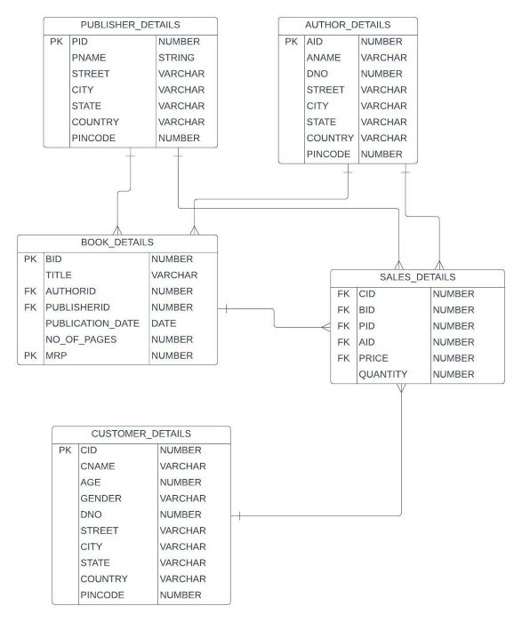
ER DIAGRAM

Slide 4
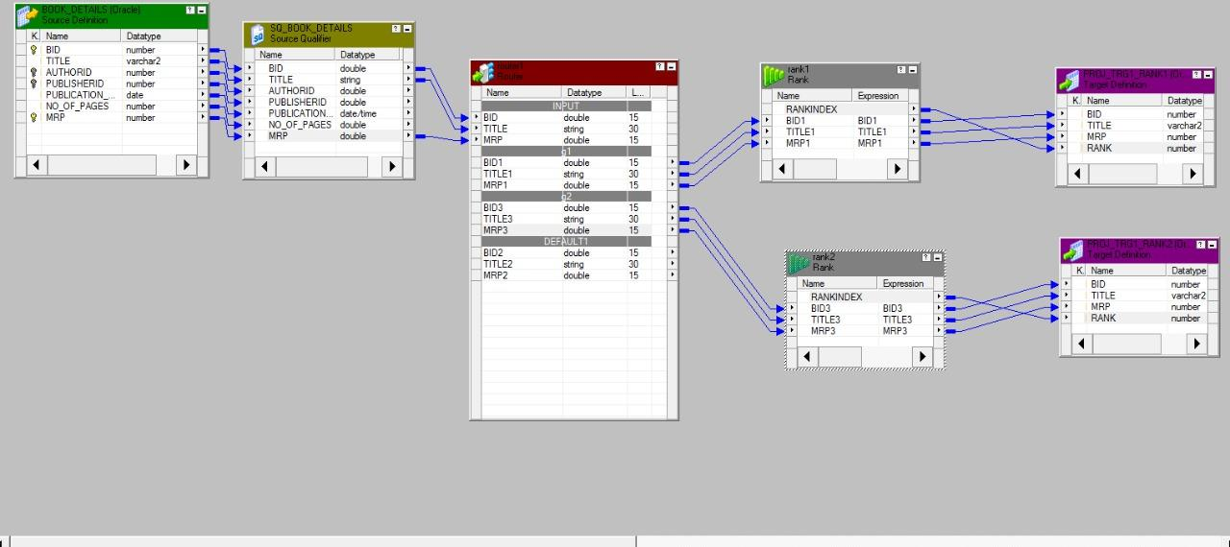
MAPPINGS
Finding the costliest and cheapest book in the store.

Slide 5
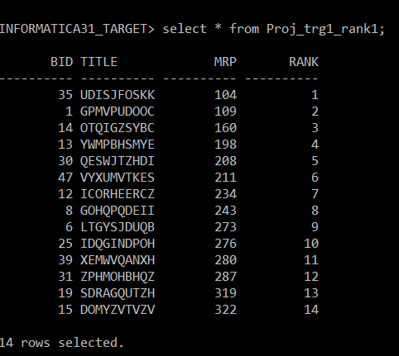
OUTPUTS
CHEAPEST BOOKS LIST:

Slide 6
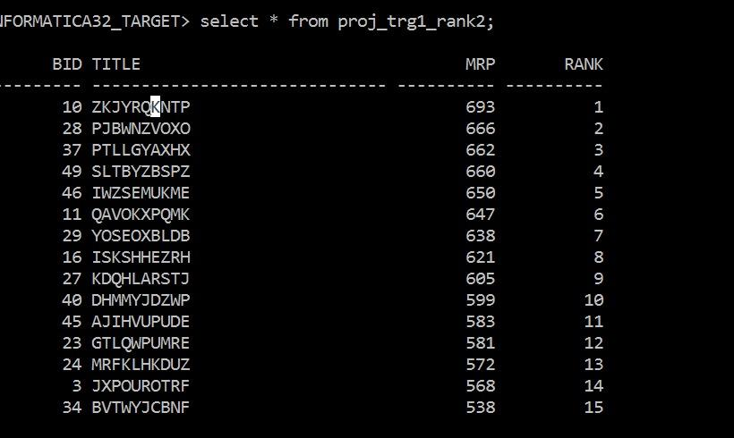
COSTLIEST BOOKS LIST:

Slide 7
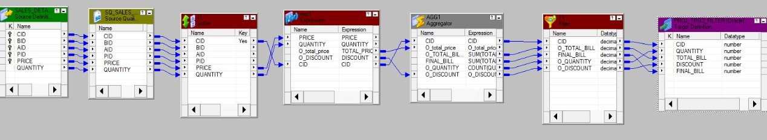
Finding the bill that customer has to pay.

Slide 8
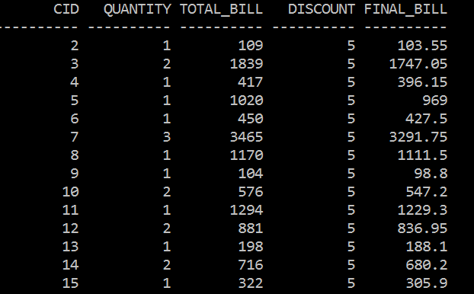
OUTPUT

Slide 9
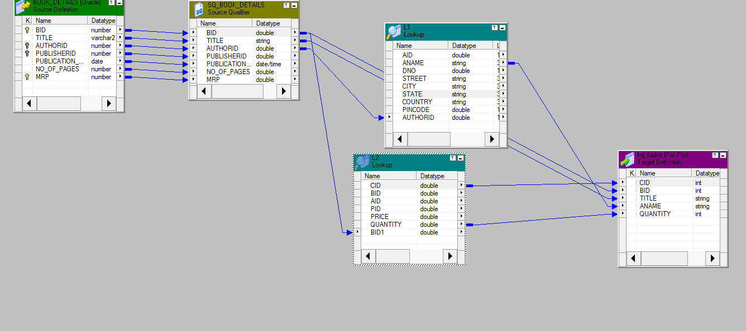
Finding the most popular books?

Slide 10
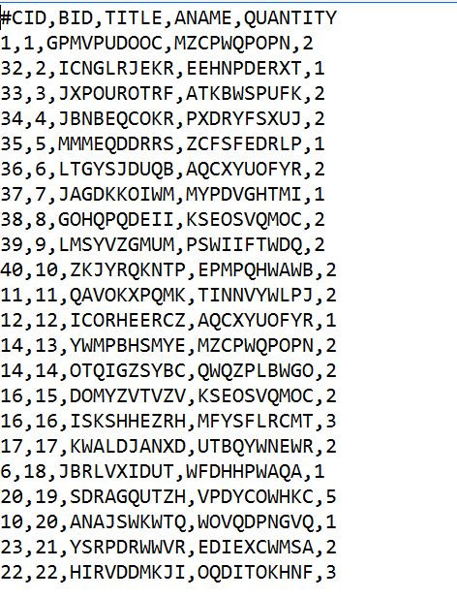
OUTPUT

Slide 11
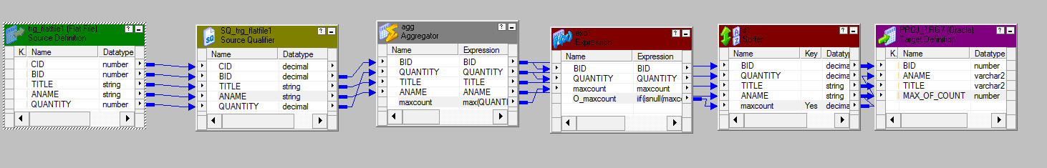

Slide 12
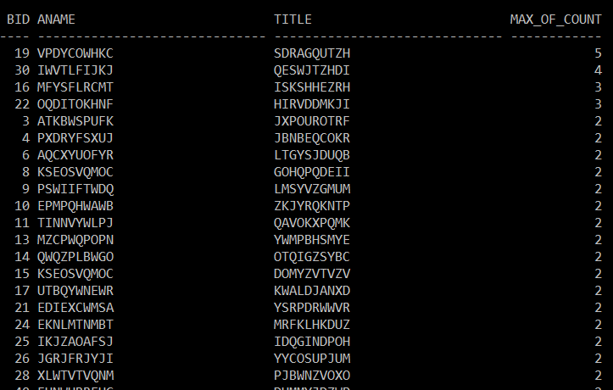
OUTPUT

Slide 13
UNIT TESTING
Unit testing involves the testing of each unit or an individual component of the software application. It is the first level of functional testing.
The aim behind unit testing is to validate unit components with its performance.
A unit is a single testable part of a software system and tested during the development phase of the application software.
The purpose of unit testing is to test the correctness of isolated code.
A unit component is an individual function or code of the application.
White box testing approach used for unit testing and usually done by the developers.

Slide 14
TEST CASE:01
Sources: BOOK_DETAILS
Mappings: M_MAPP_PROJECT_ROUTER_RANK
Targets: PROJ_TRG1_RANK1, PROJ_TRG1_RANK2,
Session: S_M_MAP_PROJECT_ROUTER_RANK
Transformations: ROUTER, RANK
Expected Results: Message in workflow manager status bar: “Workflow WF_S_M_MAP_PROJECT_ROUTER_RANK is valid “
Actual Results: Message in workflow manager status bar: “Workflow WF_S_M_MAP_PROJECT_ROUTER_RANK is valid “
Remarks: Pass

Slide 15
Sources: SALES_DETAILS
Mappings: M_MAPP_PROJECT_FILTER_AGG
Targets:PROJ_TRG3_FILTER
Session: S_M_MAP_PROJECT_FILTER_AGG
Transformations: SORTER,EXPRESSION,AGGREGATOR,FILTER.
Expected Results: Message in workflow manager status bar: “Workflow WF_S_M_MAP_PROJECT_FILTER_AGG is valid “
Actual Results: Message in workflow manager status bar: “Workflow WF_S_M_MAP_PROJECT_FILTER_AGG is valid “
Remarks: Pass
TEST CASE:02

Slide 16
Sources: TRG_FLATFILE1.TXT
Mappings: M_MAP_PROJECT_AGG_FLATFILE
Targets: PROJ_TRG7
Session: S_M_MAP_PROJECT_AGG_FLATFILE
Transformations:AGGREGATOR,EXPRESSION,SORTER
Expected Results: Message in workflow manager status bar: “Workflow WF_S_M_MAP_PROJECT_AGG_FLATFILE is valid “
Actual Results: Message in workflow manager status bar: “Workflow WF_S_M_MAP_PROJECT_AGG_FLATFILE is valid “
Remarks: Pass
TEST CASE:03

Slide 17
INTEGRATION TESTING
Integration testing is the second level of the software testing process comes after unit testing. In this testing, units or individual components of the software are tested in a group. The focus of the integration testing level is to expose defects at the time of interaction between integrated components or units.
Unit testing uses modules for testing purpose, and these modules are combined and tested in integration testing. The Software is developed with a number of software modules that are coded by different coders or programmers. The goal of integration testing is to check the correctness of communication among all the modules.
Once all the components or modules are working independently, then we need to check the data flow between the dependent modules is known as integration testing.

Slide 18
TEST CASE:01
Source Tables : BOOK_DETAILS
Target Tables : PROJ_TRG1_RANK1, PROJ_TRG1_RANK2
Transformation: ROUTER,RANK
Expected Result:
Check Mapping> Mapping is validate
Go to workflow > Message in workflow manager status bar : “WorkflowWF_S_M_MAP_PROJECT_ROUTER_RANK is valid”
Actual Result:
Message in workflow manager status bar : ”Workflow WF_S_M_MAP_PROJECT_ROUTER_RANK is valid”
Remarks : Pass

Slide 19
TEST CASE:02
Source Tables : SALES_DETAILS
Target Tables : PROJ_TRG3_FILTER
Transformation:Sorter,Expression,Aggregator,Filter
Expected Result:
Check Mapping> Mapping is validate
Go to workflow > Message in workflow manager status bar: “Workflow
WF_S_M_MAP_PROJECT_FILTER_AGG is valid”
Actual Result:
Message in workflow manager status bar : “Workflow WF_S_M_MAP_PROJECT_FILTER_AGG is valid
Remarks : Pass

Slide 20
Source Tables : TRG_FLATFILE1.TXT
Target Tables : PROJ_TRG7
Transformation: AGGREGATOR, EXPRESSION
Expected Result:
Check Mapping> Mapping is validate
Go to workflow > Message in workflow manager status bar:“Workflow WF_S_M_MAP_PROJECT_AGG_FLATFILE is valid”
Actual Result:
Message in workflow manager status bar : ”Workflow WF_S_M_MAP_PROJECT_AGG_FLATFILE is valid”
Remarks : Pass
TEST CASE:03

Slide 21
REGRESSION TESTING
The goal of Regression testing is to verify that the data in the source table will remain same before and after the mapping.Regression testing is a black box testing techniques.It is used to authenticate a code change in the software does not impact the existing functionality of the source table.Regression testing is making sure that the source table works fine with new functionality,bug fixes,or any change in the existing feature.
Regression testing is a type of software testing.Test cases are re-executed to check the previous functionality of the application is working fine, and the new changes have not produced any bugs.

Slide 22
1) Test Case ID: T1
Test Case Purpose:Validate Mapping M_MAPP_PROJECT_ROUTER_RANK,Validate Workflow, WF_M_MAPP_PROJECT_ROUTER_RANK
Input Value/Test Data:
Source Tables : BOOK_DETAILS
Target Tables :PROJ_TRG1_RANK1,PROJ_TRG1_RANK2
Transformation:ROUTER,RANK
Expected Result:
Check Mapping> Mapping is validate
Go to workflow > Message in workflow manager status bar: “Workflow
WF_S_M_MAP_PROJECT_ROUTER_RANK is valid”

Slide 23
Actual Result:
Message in workflow manager status bar : ”Workflow WF_S_M_MAP_PROJECT_ROUTER_RANK is valid”
Remarks : Pass
Tester comments:Retrieved the data from source table SALES_DETAILS and grouped it in 2 categories BID , Title, MRP using transformations. The source table SALES_DETAILS contains 66 rows of data. The date remains the same after the transformation.

Slide 24
2) Test Case ID: T2
Test Case Purpose: Validate Mapping, M_MAP_PROJECT_FILTER_AGG,Validate Workflow, WF_S_ M_MAP_PROJECT_FILTER_AGG
Input Value/Test Data:
Source Tables : SALES_DETAILS
Target Tables : PROJ_TRG3_FILTER
Transformation: SORTER, EXPRESSION,AGGREGATOR,FILTER.
Expected Result:
Check Mapping> Mapping is validate
Go to workflow > Message in workflow manager status bar: “Workflow WF_S_M_MAP_PROJECT_FILTER_AGG is valid”

Slide 25
Actual Result:
Message in workflow manager status bar : “Workflow WF_S_M_MAP_PROJECT_FILTER_AGG is valid”
Remarks : Pass
Tester comments:Retrieved the data from the SALES_DETAILS and sorted,aggregated to find the bill the customer has to pay. This data will be useful to know billing details of each customer. The source table SALES_DETAILS contains 66 rows of data. The date remains the same after the transformation.

Slide 26
3) Test Case ID: T3
Test Case Purpose: Validate Mapping, M_MAP_PROJECT_AGG_FLATFILE,Validate Workflow, WF_S_ M_MAP_PROJECT_AGG_FLATFILE
Input Value/Test Data:
Source Tables : TRG_FLATFILE1.TXT
Target Tables : PROJ_TRG7
Transformation:AGGREGATOR,EXPRESSION
Expected Result:
Check Mapping> Mapping is validate
Go to workflow > Message in workflow manager status bar:“Workflow WF_S_M_MAP_PROJECT_AGG_FLATFILE is valid”

Slide 27
Actual Result:
Message in workflow manager status bar : ”Workflow WF_S_M_MAP_PROJECT_AGG_FLATFILE is valid”
Remarks : Pass
Tester comments:Retrieved the data from TRG_FLATFILE1.TXT and used the aggregator transformation on the data. This data is used to find the mostly sold out book and also the books which are not sold at least once. The target flat file contains 66 rows of data. The data remains the same after the transformation.

Slide 28
THANK YOU

